Slide 1

STORYTELLING
What makes a good Story?
Presented by Annie Carter

Slide 2

THE ART OF CHARTS
1
Love me, Love me NOT
2
Clear vs Murky
3
Decepticons
4
Critiquing Slides

Slide 3
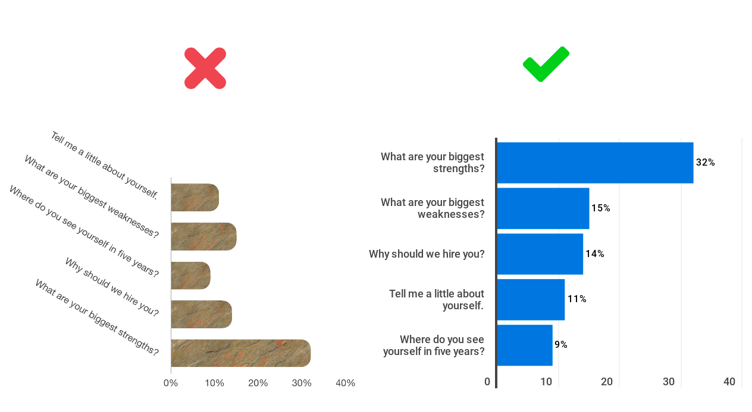
CHARTS
LOVE ME, LOVE ME NOT
Chart I Like
Chart I do NOT Like
For optimal readability, avoid using vertical text to label your bars in a bar chart. The horizontal nature of the bars allows for easy reading,
so it's best to keep the labels horizontal as well.
SOURCE: https://infogram.com/blog/do-this-not-that-bar-charts/

Slide 4
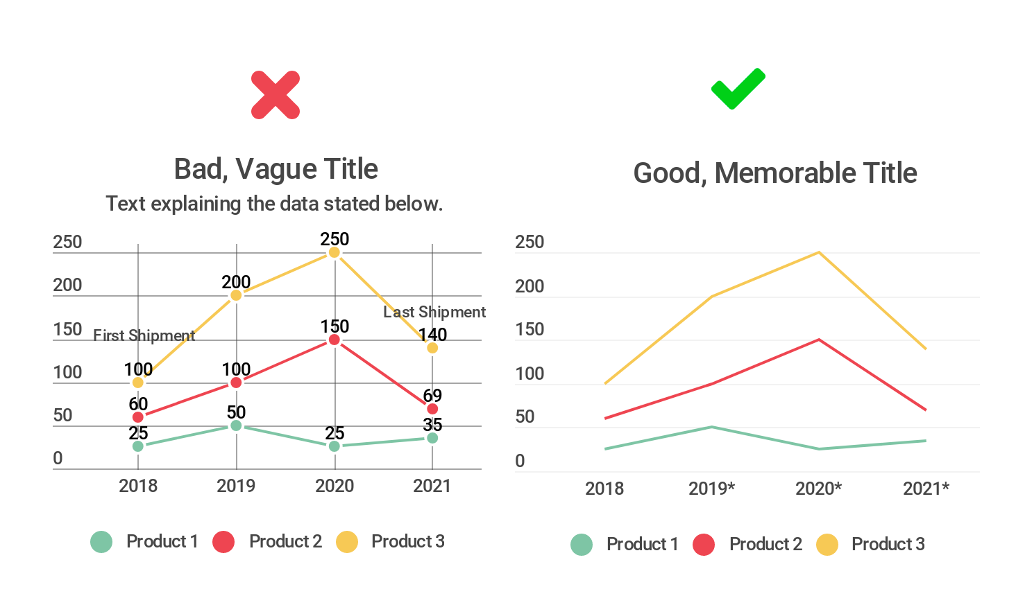
CHARTS - CLEAR VS MURKY
Murky
Clear
Avoid overwhelming your viewer by refraining from including excessive information in text form within your chart. Be selective in the text you choose to incorporate, focusing on key elements. Give your chart a concise and memorable title that captures its essence. If you're visualizing data obtained from a source other than your own, consider including a small, unobtrusive attribution to acknowledge the source without distracting from the main content.
https://infogram.com/blog/do-this-not-that-data-visualization-before-and-after-examples/

Slide 5

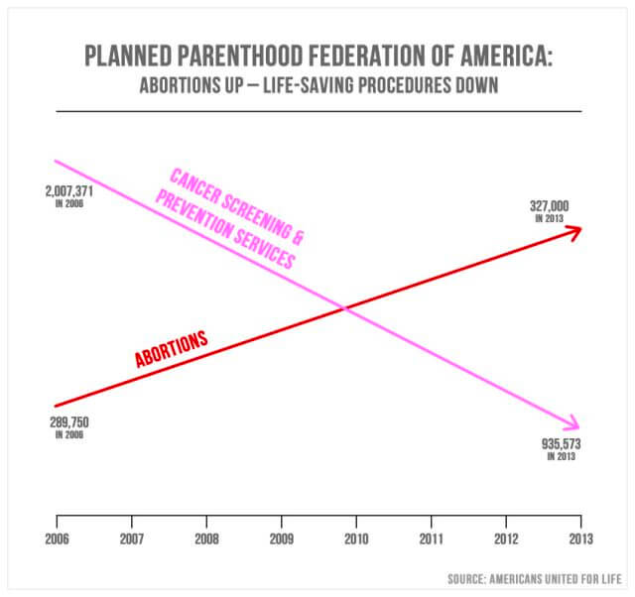
DECEPTICONS - CHARTS THAT DECEIVE
The dual-axis chart presented to the U.S. Congress in September 2015 is often regarded as one of the most deceptive charts. Its issue lies in the absence of a clear y-axis, resulting in arbitrary placement of the lines. Moreover, the scaling of the cancer screening line in millions and the abortion line in hundreds of thousands creates a misleading impression of a sharp increase in abortions and a drastic decline in cancer screenings, which does not reflect the actual situation.
https://infogram.com/blog/do-this-not-that-data-visualization-before-and-after-examples/

Slide 6

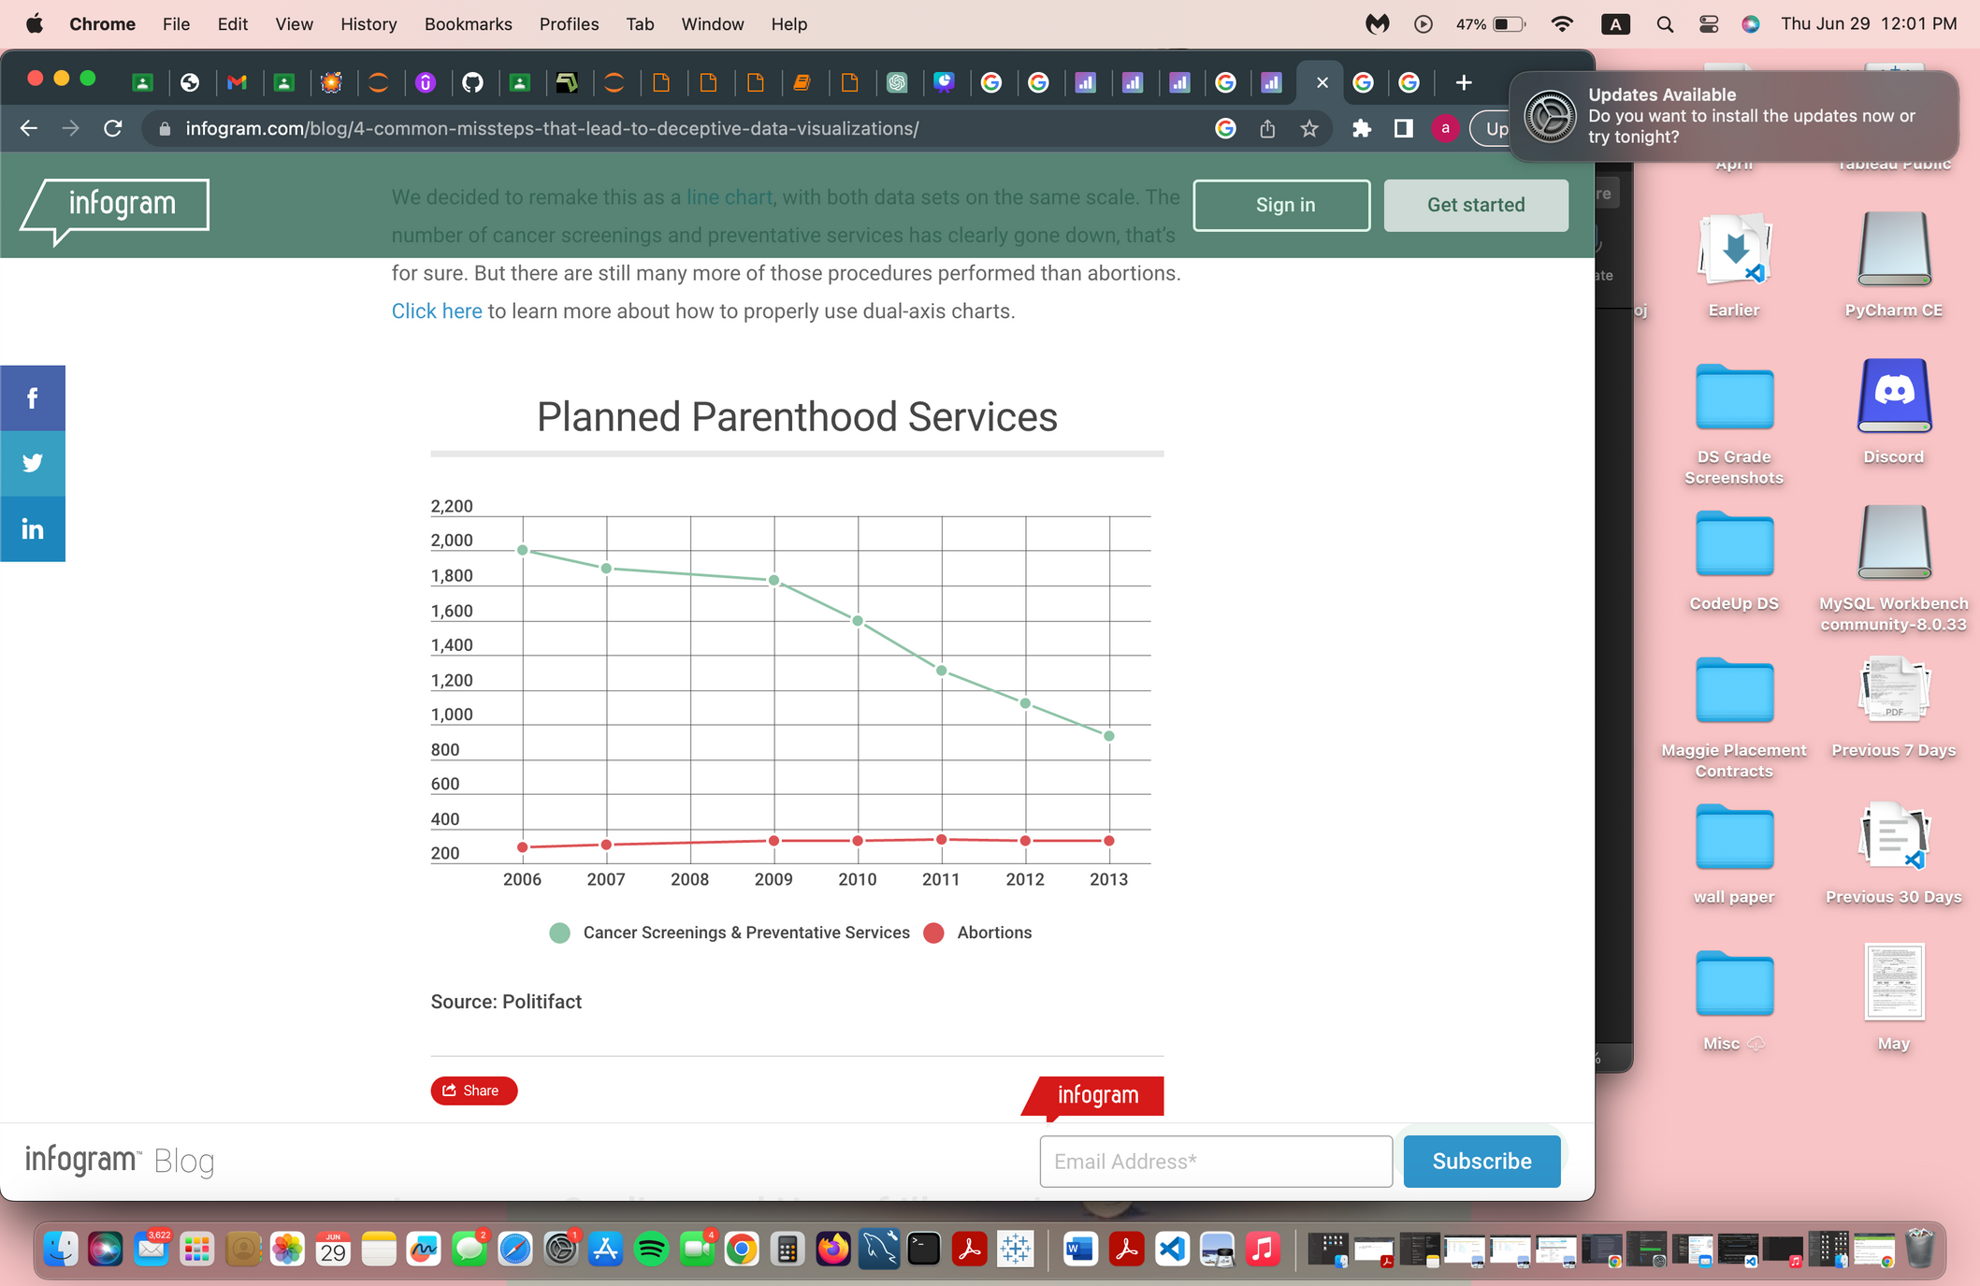
CRITIQUING CHARTS
Before
After
5. I like the use of chronology x-axis, Dislike scaling & wish the graph was redone
6. 3 ways the original slide was improved:
The chart format: The original chart was remade as a line chart, providing a different visual representation.
Data scaling: Both data sets were adjusted to be on the same scale in the remade line chart, ensuring a fair comparison.
Comparative analysis: The remade chart revealed that the number of cancer screenings and preventative services has decreased. However, it also highlighted that there are still significantly more of those procedures performed compared to abortions, emphasizing the difference in magnitude between the two.
7. The “After” chart is another version of previous graph
The critique of the first slide in the chart includes:
The fist thing I saw was lack of y-axis and confusing information
Lack of clarity on intent and effective visualization.
Misleading data, which can result in misconceptions or incorrect interpretations.
Missing y-axis, making it challenging for viewers to grasp the scale and reference points of the data.
https://infogram.com/blog/4-common-missteps-that-lead-to-deceptive-data-visualizations/

